Slide 1
Scotland’s Environment Web www.environment.scotland.gov.uk
Aims to be the “Trusted” gateway to everything you want to know about Scotland’s Environment, bringing together the most up to data environmental information and data in the one place, so that it is easy to find, view, analyse and interpret
Transformational shift from Data Rich to Information Rich.
Notes:
Project Aim : Scotland’s Environment web site aims to be the “trusted” gateway to everything you want to know about Scotland’s Environment, bringing together the most up-to-date environmental information and data in once place, so that it is easy to find, view, analyse and interpret.
3.5 year programme launched in November 2011
Supported by EU LIFE Funding
Move to a web based, dynamic approach to accessing and presenting information and data from multiple sources, in one place
Providing access to the most up-to-date environmental information and data published
A “Trusted” source of data and information on Scotland’s Environment
Exemplar project – innovating, shared learning and knowledge exchange
What is SEWeb : Scotland’s Environment Web is not a data repository. Through a common approach to open data standards (e.g. INSPIRE for spatial data), Scotland’s Environment web site provides a one-stop-shop to help users find and access the extensive range of information and data that is currently spread across multiple organisations and many different web sites. It goes beyond just finding, listing and signposting to data– it is developing tools and applications to help data users manipulate, analyse, interpret and understand data – making a transformation shift from data rich (current position) to information rich (where we want to be).

Slide 2
Scotland’s Environment Web Partners
Notes:
Logos of just a few of our partners…..
Extending the “Web” of partner engagement – This is being achieved through a multi-agency collaborative approach, which is at the very heart of the Scotland’s Environment Web project – relying heavily on the data, information, expertise and advice of our partners. The project therefore has to engage with partners, create a sense of ownership of the project and what it is working towards, and ultimately deliver products/tools that deliver demonstrable benefits and added value to all of our partners. Two examples of partner engagement is:
The project has developed a methodology and ran an in-depth assessment of Key Environmental Issues facing Scotland – involving around 110 experts from across Scotland to assess the state of relevant SoE topics, and the drivers/pressures that put them into that state.
We have gone through a partnership approach to assessing and reporting on the State of Scotland’s Environment, producing 27 topics written by a range of experts from Scotland’s leading environmental organisations. Never before has there been such a high level of collaboration across so many organisations to publish this “authoritative and trusted” view of the State of Scotland’s Environment in one place.

Slide 3
Web platform to find data; get information from data; and use it to inform, understand, decide and behave....
Streamline access to multiple sources of data and information
Provide a single “authoritative” view of Scotland’s environment
Present data from multiple sources in one place, interesting and dynamic data views, exploring relationships, supporting analysis and prioritisation
Public engagement through Citizen Science and Public/Youth Discussion, and community empowerment to take action
Extended communication networks and reach new audiences
Notes:
This current phase of the project (up to August 2015) will extend the partnership of data providers, develop innovative tools and applications, improve data usability and connectivity, and establish a user focussed web site that will:
provide a platform for shared services that will achieve efficiency savings to the data provider and data user, by developing a range of online applications and web tools to facilitate quicker and easier access to environmental information and data;
deliver a single point of access to environmental data and a single “authoritative” view of Scotland’s environment, and will streamline reporting to Europe
improve sharing, analysis and presentation of environmental information through an enhanced network of partnerships between interested organisations, businesses, groups and individuals;
improve understanding of Scotland’s environment through new data presentation, visualisation and analysis tools
improve methods of identifying and prioritising environmental problems, and targeting measures to manage and improve Scotland’s environment; and
seek to actively involve the public, schools and academics in developing understanding of the environment and improving the way we protect it through citizen science and behaviour change.

Slide 4
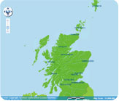
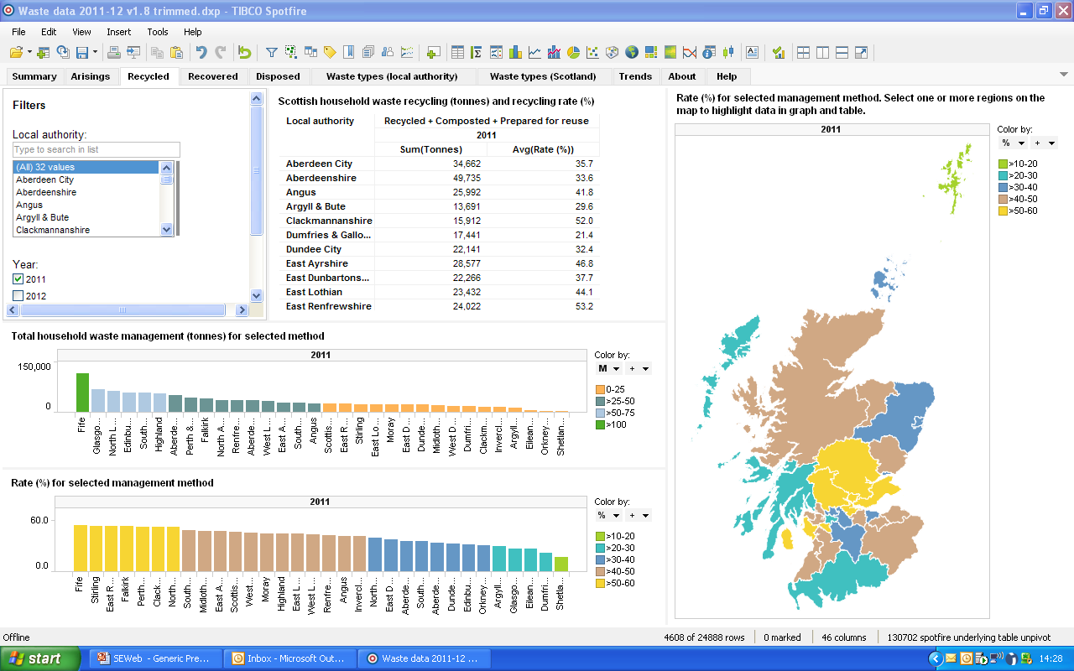
Data, Data, Data
Notes:
Scotland’s Environment web aims to significantly increase the amount of data and information accessed and viewed on the web site – the whole premise of SEWeb is to provide a “gateway to information and data” – which means it is absolutely reliant on the data and information that it can consume, as served up/published by partner organisations – to Scotland’s Environment is VERY data hungry !
we now have over 300 data sets from a range of different organisations. No where else can users view any combination of environmental spatial data in the one place. Scotland’s Environment Map View draws on publicly available Web Map Services published under the INSPIRE Directive so what users see is the most up-to-date map data that is currently available.
Discover Data presents a range of data visualisation tools for House Hold Waste and Water Classification Scottish Climate Projections and Bathing waters. Following very soon are Native Woodland Survey for Scotland, Climate Trends, Ground and Surface Water, Scottish Pollutant Release Inventory, and more….
Working on new Indicators and Data section of the web site that will provide easy access and new interactive data views/interactions to the range of environmental data sets that underpin the SoE Assessment. Working with ScGovt in the first instance, Scotland’s Environment Web will host the Scottish Environmental Statistics Online data and through linked data mechanisms, these will be directly relatable to the European Environment Agency SoE Indicators.
Land information search tool - A collaborative partnership project with SNH, FCS and SEPA has developed a new interactive land search mapping search tool that enables the querying and reporting of features which fall within a user defined polygon search area and produces a report derived from a spatial search of over 30 different open data sets published by multiple partner organisations.
Providing a one-stop-shop to a whole range of useful information sources and data tools

Slide 5
Shared Environmental Information System “One version of the truth” - Publish once, Use many times, Different users
Notes:
We’re moving away from Single Purpose Data publication – towards Shared Environmental Information System
Scotland’s Environment Web consumes open data, published by partners/data providers (Web Map Services, Web Feature Services, Data Download Services) and presenting it in different ways and in different applications to make it easier for data users to find and understand the myriad of data that is currently published across multiple different web sites.
Benefits of SEIS
Better Regulation, better policy
Empowering Citizens
Simplification and Efficiency
Intelligent e.services – Strategic Environmental Impact Assessment, Environmental Impact Assessment, Prevention and Management of Environmental Risks/Harms, prioritising Environmental Issues

Slide 6
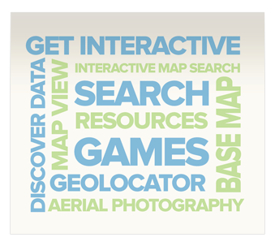
New website & structure
Notes:
New website launched on 5th June
New structure to take users on a journey of search, find, discover :
Get Informed - about the State of Scotland’s Environment and the data (indicators) that underpin the assessment;
Get Interactive - with different data sets through analysis and visualisation tools that will improve understanding;
Get Involved - in discussion, monitoring and action; and
Get Communicating - to find out the latest environmental news and share information through social media on environmental topics of interest.
Improving connectivity between different sections of the website - “follow the icon”

Slide 7
Spatial Data – Map View
SoE Themed Maps – recommended data sets
Choose to view any combination of data from multiple sources (nearly 300 data sets)
Notes:
Nearly 300 INSPIRE Directive spatial data sets are now viewable on the Scotland’s Environment Web Map View, with new functionality including 4 different baselayer map options including aerial photography and a geolocator that picks up the users GPS location to search for localised spatial data view.
Mainly harvested from SSDI (Scottish Spatial Data Infrastructure) – turning data into a more interactive viewing platform

Slide 8
Land Information Search
Draw area on map, run search of 40+ open data sets – always the most up-to-date data)
View designations that fall within the 500m buffer zone (aerial photography view)
View designations that fall within the defined area of interest (Ordnance Survey Basemap view)
Run search and print off report - list of all designations & organisation to contact for more information e.g. SEPA, FCS, Historic Scotland, SNH
Notes:
Partnership project with SNH, FCS and SEPA - enables the querying and reporting of features which fall within a user defined search area and will produce a report derived from a spatial search of nearly 40 different data sets published as web map services by multiple partner organisations.
LIS is for use by those applying for forest felling permits, plus wider agricultural and moorland management stakeholders e.g. landowners, agents working on behalf of land owners, public or business sector searching for information required for an Environmental Impact Assessment, land and forestry agents applying for SRDP grants, and interested members of the general public.
The land search application aims to streamline and improve access to the environmental information that will in turn improve the quality of applications made by developers and therefore quicker approval decisions.
Further iterations of same tool for different user groups are planned (e.g. wind farm applications and environmental risk assessment).

Slide 9
Data Visualisation
Notes:
Visualising significant quantities of complex raw data (10’s of thousand’s of rows of data) and rapidly turning them into visual, interactive graphs, maps and charts. Allows users to quickly view, interrogate and interpret significant quantities of complex data. All data viewed by the application can be exported for use in reports and presentations.

Slide 10
Scotland’s Environment Web Take a Look at the new website
www.environment.scotland.gov.uk

Slide 11
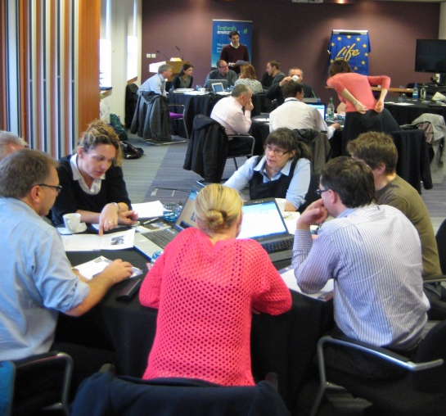
Engaging with Scotland’s Citizens
Scotland’s Environment Web is more than just a web site
Engage the public by providing high quality online interactive resources to promote better understanding of the environment, public discussion on environmental priorities, public monitoring of the environment and public activity to protect and improve the environment
Discussion
Monitoring
Action
Notes:
Scotland’s Environment Web is not just about information and data on the web site.
One the Project’’s four key objectives is ‘to engage the public by providing access to high quality on-line interactive resources to promote better understanding of the environment, public debate on environmental priorities, public monitoring of the environment and public activity to protect and improve the environment’ There are a wide range of engagement activities that have, and have taken place, including :
1) Public discussion
2) Youth Discussion
3) Citizen Science register – Project Finder
A lot of European interest in the Public Engagement workstream – and how we evaluate behaviour change as a result of the provision of information & data, and involvement in environmental monitoring – SEWeb has developed a public engagement evaluation strategy with partners/experts – ongoing monitoring and evaluation. Available on the web site.
Might ask question about how this is being evaluated – Jo will review evaluation strategy and will have notes

Slide 12
Public Discussion
Collect evidence
Understand public views
Test new methods
Targeted engagement on real issues
Influence behaviours and values
Encourage more environmental stewardship
Notes:
Why did we do it ?
Collect evidence to help identify those issues and actions that are most meaningful and acceptable to the public, assess the level of public agreement with the key issues identified for Scotland’s Environment with the ultimate aim of influencing public behaviour and thereby environment benefits
Test new and innovative ways of public engagement and share learning (LIFE+ funding – demonstration programme)
See if the public share the same view on Environmental Priorities as the Scotland’s Environment “experts”
Understand why the public hold the views they do and whether views change as a result of more information
How did we go about it:
Worked with Ipsos Mori – independent social research experts
Deliberative workshops – 25-30 participants recruited by IPSOS Mori (“General” public) at 3 workshops throughout Scotland (Edinburgh, Inverness and Dumfries)
Online discussion forum – set up and moderated by IPSOS Mori – ran for 1 month, promoted via Scotland’s Environment web site, social media, parents of children participating in the youth discussion, and invite participants of the deliberative workshops
5 key issues were discussed (briefing notes available on the website) – Climate Change, Built Environment, Land Management, Freshwater, Marine Environment
And Actions for Individuals, business and government
What difference will it make
Targeted public engagement on the real issues that they are interested, and not what we (partner organisations/agencies) think the public are interested in
Shared learning on new methods of effective public engagement – published a Public Discussion toolkit/methdology
Enhanced organisational reputation and credibility, influence social behaviours towards more positive environmental values and bring about real environmental improvements
Encourage more environmental stewardship – can’t rely on regulation and science alone to deliver environmental protection and improvement outcomes, Scotland’s citizens have a large role to play in achieving these outcomes through personal behaviours and action to prevent environmental problems arising and small problems becoming significant problems, and to realise environmental improvements.

Slide 13
Scotland’s Environment Web “Family”

Slide 14
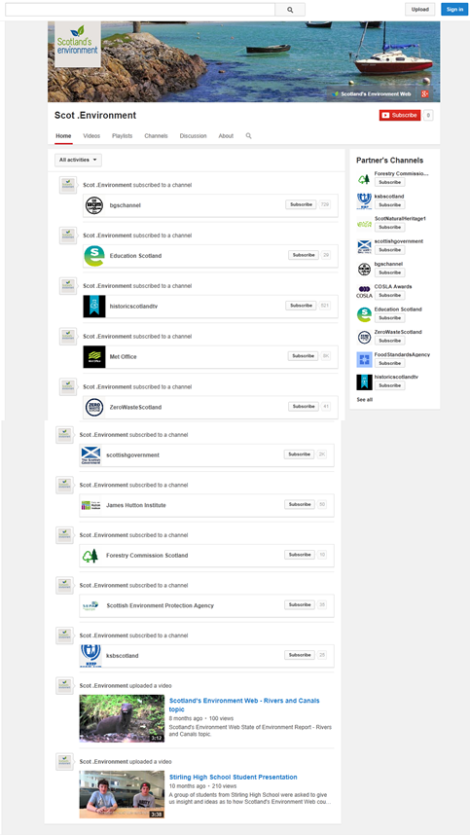
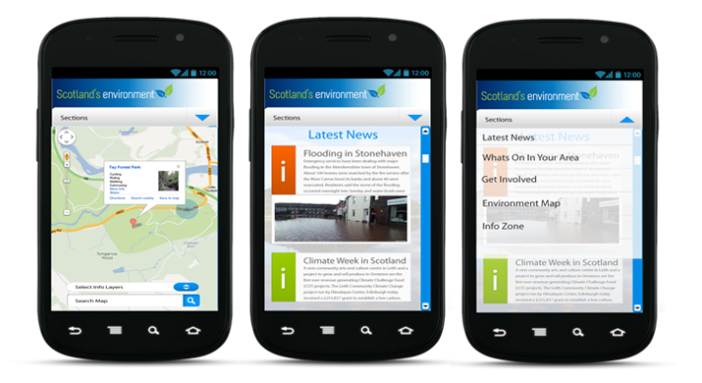
Communicating and Engaging - Beyond the website
Notes:
Scotland’s Environment Web is more than just a website
Social media is an extremely powerful tool for increasing web presence and engagement with potential users. Currently nearly 60% of people, over the age of 16, in the UK are members of and regularly use some form of online social network. This rises to 94% for those aged between 16 and 24.
SEWeb is growing its social media profile, to extend the reach and scope of communications and key messages e.g. from June to August 2014 – facebook posts reached over 10,000 people, and twitter mentions of @ScotEnvironment reached over 40,000 people
The need for information ‘on the go’ forms part of many people’s everyday lives now with the rise of smartphones and tablet computers. More people accessing internet via mobile devices than PC’s.
Scotland’s Environment web needs to become more mobile friendly (mobile view, mobile app versions of products) – in the future, working more with the creative and digital sector to develop new and innovative ways of accessing, viewing the environmental data agencies hold, and new ways of collecting data from the public.

Slide 15
Scotland’s Environment Web
Through innovation, demonstration, shared learning and collaborative working, create a Web of :
Data providers
Data users
Shared knowledge and data
Environmental Scientists and Observers
Environmental Stewards
Benefit the Environment, Society and the Economy

Slide 16
For further information or questions
seweb.administrator@sepa.org.uk

